Slide 1
Advanced Data Visualization
Etana Disasa
College of Computer & Information Sciences
Regis University

Slide 2
Introduction
This dataset “Drug Poisoning Mortality by County: United States” was retrieved from CDC Data.
It includes several data points including death rates by country which could also be grouped by state and geographical classification.
The data accounts for a time frame from 2003 – 2020

Slide 3
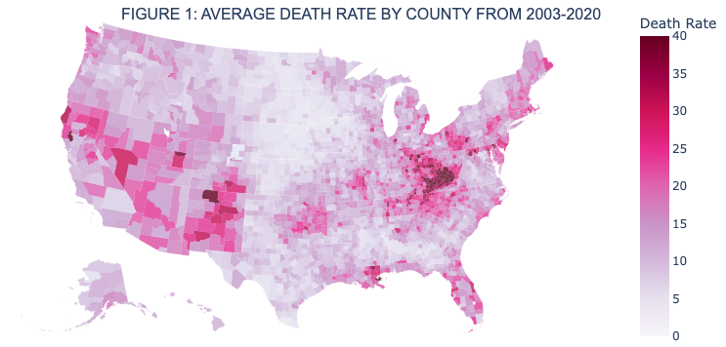
Average Drug Poison Death Rate by County
Figure 1 displays an 18 years average drug poisoning death rate (death rate) across the united states by each county.
This choropleth map displays that certain regions in the south western and mid east United States have witnessed higher death rates.
It is also visible that the center of the country (vertically) appear to have lower death rates.

Slide 4
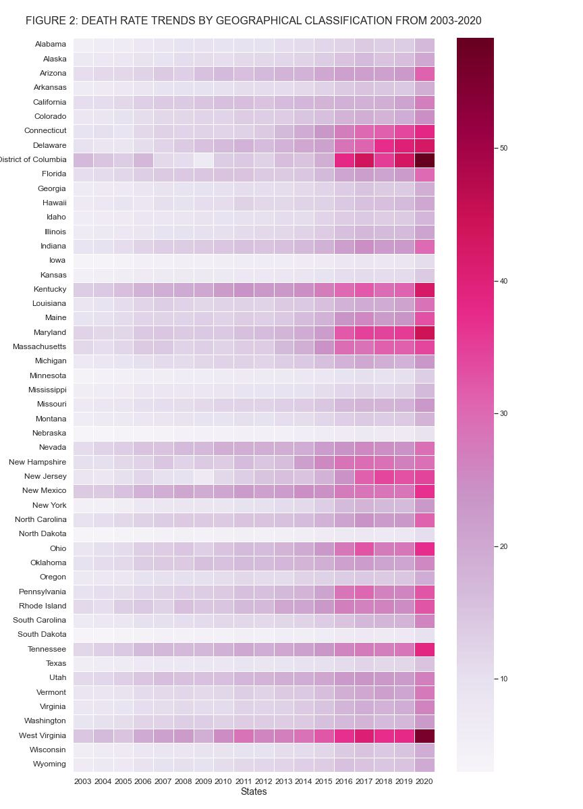
Traffic Volume on Holidays
After more data analysis, this heat map is populated with death rate (drug poisoning) across the U.S. states and territories from 2023 – 2020.
It is evident that across the united states, the death rate has increased.
In particular, District of Columbia and West Virginia have witnessed significant increase.

Slide 5
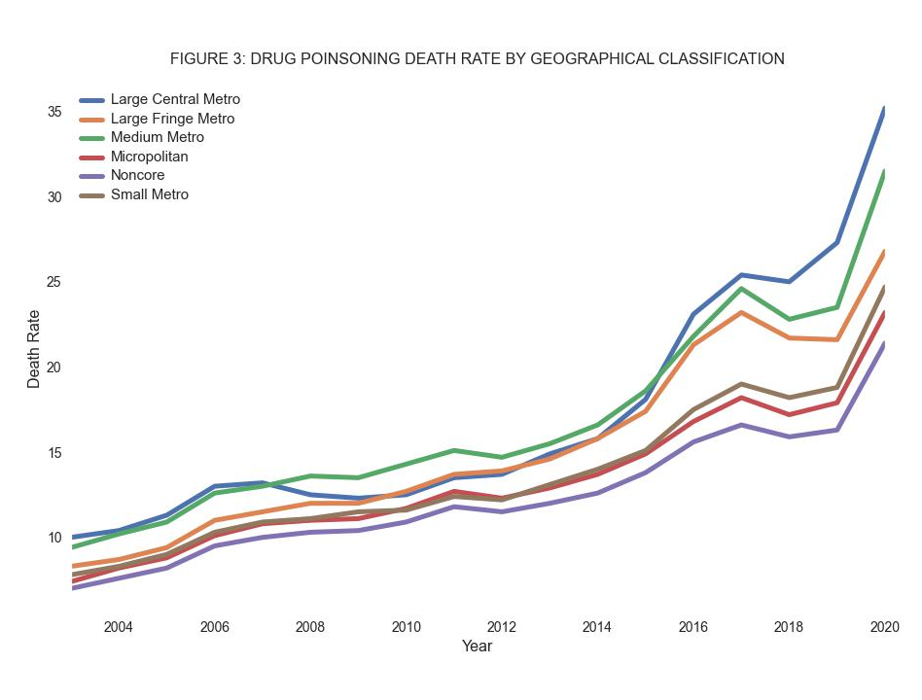
Traffic Volume in Different Weather Conditions
Another matrix included in this dataset was geographical classification.
This line chart shows that over the time span of 2003-2020, all geographical class has shown an uptick in death rate.
Large Central Metro areas witness the highest average death rate.

Slide 6
Conclusion
Drug poisoning death rate (death rate) across the United States shows a continuous increate across the country.
Certain counties particularly in the south west and mid east of the country has experienced more rate.
Nevertheless, when the data is grouped by states, each state has shown witnessed increased death rates.
Unlike popular assumption, the increase wasn’t just an urban issue. Across all geographical classification, death rate has increased.

